Slide 1
CCC Presentation Hera-Federation Complex Project Update
19 August 2025

Slide 2

Acknowledgement of Country
Aurelia Metals Ltd respectfully acknowledges the Ngiyampaa Nation as the Traditional Custodians of this land – both past and present.
We know this land has history, custodians and stories, spanning tens of thousands of years, that endure to this day.
We pay our respects to Elders both past and present and we embrace their continued connections to this place.
We commit to reconciling the past and working together in pursuit of knowledge and understanding as we seek to create a better future for all generations yet to come.

Slide 3
Federation-Hera Complex: Progress Update
Tracking Key Dates
June Q FY25 — Federation ramp‑up on plan
Kidman Way upgrade: originally scheduled to start at Priory Tank Road on 15 Feb 2025 and then move to the Peak intersection. Due to TfNSW design‑approval delays, works are now likely to commence in Sep/Oct 2025.
Independent Environmental Audit report is being finalised and scheduled for submission to the NSW Department of Planning, Housing and Infrastructure (DPHI) by 20 Aug 2025.
The audit assesses our compliance with the Project Approval conditions and supporting management plans. Audit outcomes will be made public on the company website.
Mine development: 1,134 m (MarQ: 877 m).
Ore mined increased 57% to 53 kt (MarQ: 34 kt); 106 kt mined in FY25 YTD.
Federation ore processed throughout the quarter with 55 kt treated at Peak — strong throughput and recovery maintained.
Project capital this quarter: $10.8 M, taking total FY25 Federation growth capital to $66.4 M.
Cobar Basin Optimisation — Board Approval
8 Aug 2025: Board approved the Tertiary Ball Mill and the Crushing & Materials Handling Expansion projects (part of the Cobar Basin Optimisation program).
All Cobar Basin Optimisation projects are now approved. These will increase Peak Processing Plant capacity to ~1.1–1.2 Mtpa, enabling treatment of all Federation ore alongside Peak South Mine and New Cobar (incl. Great Cobar) ores.

Slide 4
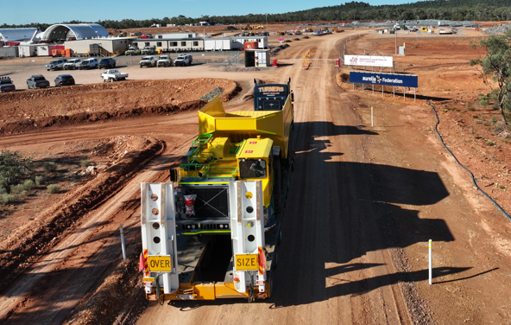
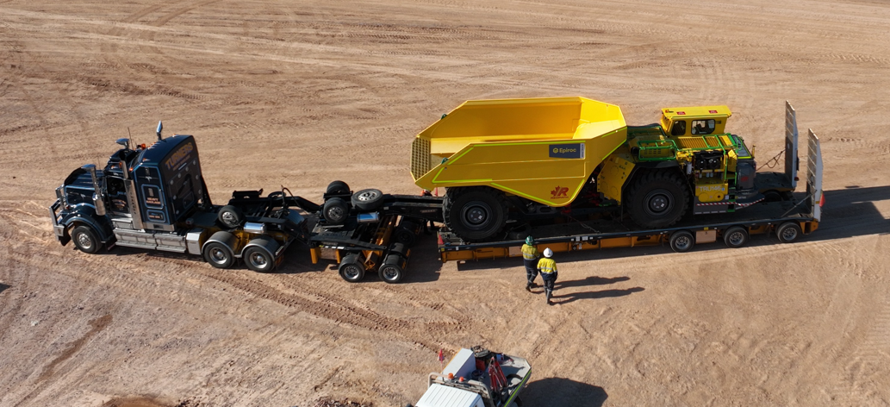
Federation-Hera Complex: Progress Update
New truck being delivered to site

Slide 5
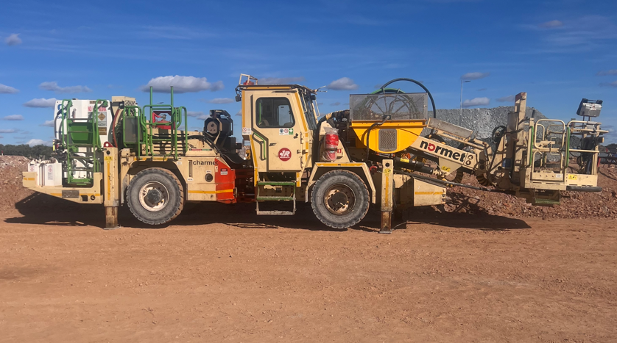
Federation-Hera Complex: Progress Update
New Nomet Charmec rig for emulsion delivered to site

Slide 6
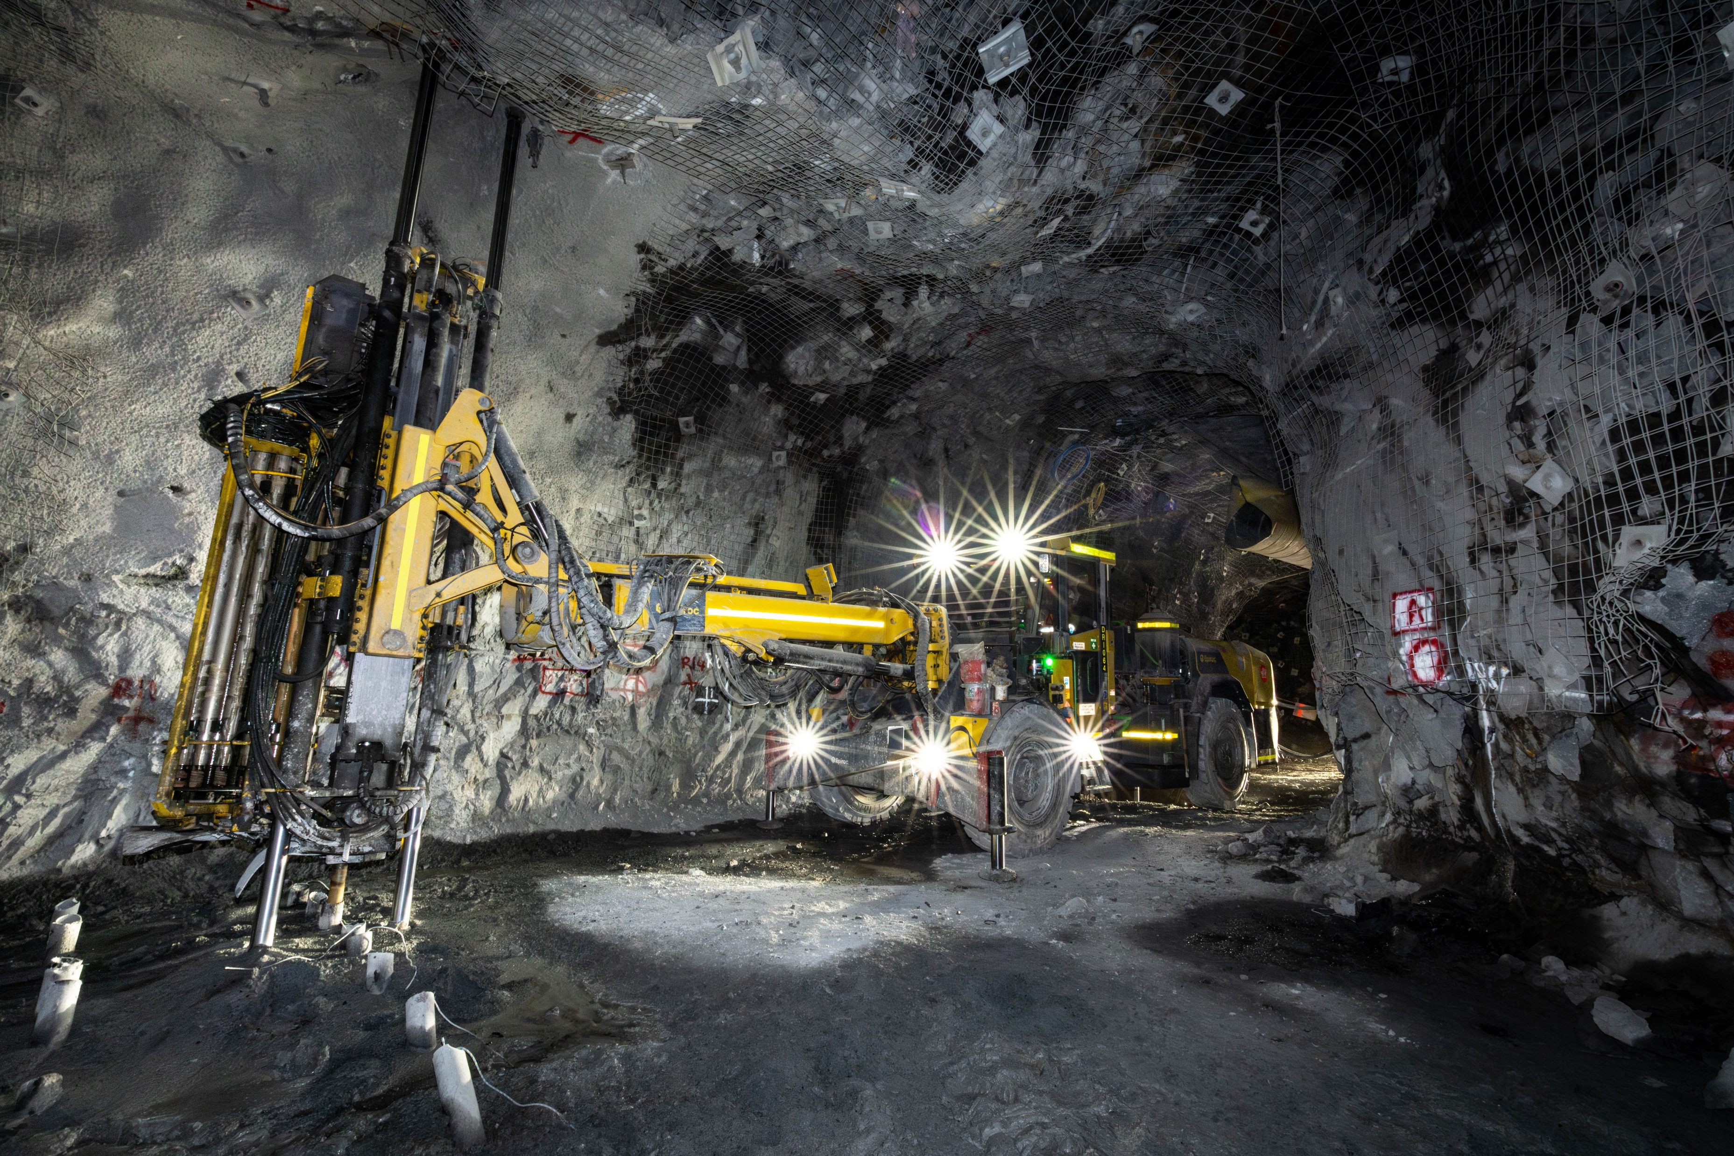
Federation-Hera Complex: Progress Update
New Long Hole Epiroc E30S delivered to site

Slide 7
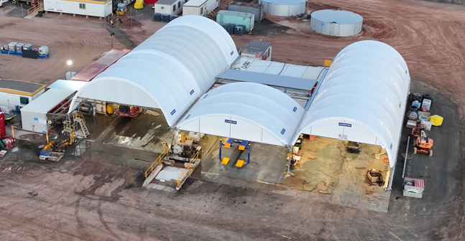
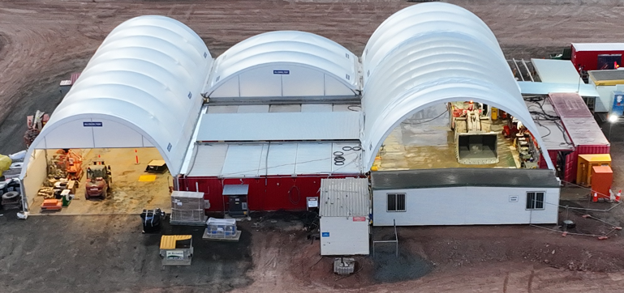
Federation-Hera Complex: Progress Update
Workshop construction complete

Slide 8
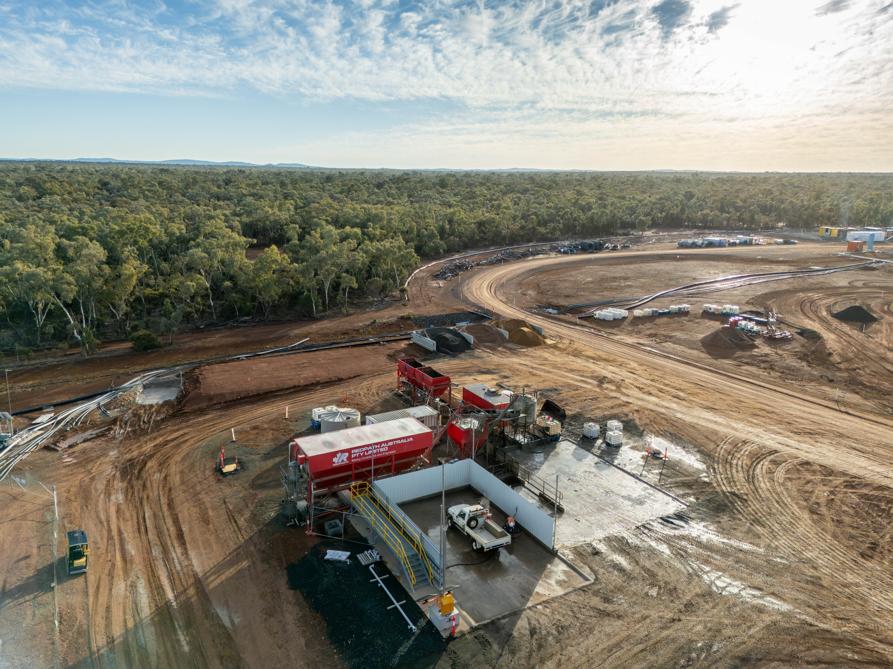
Federation-Hera Complex: Progress Update
Wash bay and concrete batch plant construction complete

Slide 9
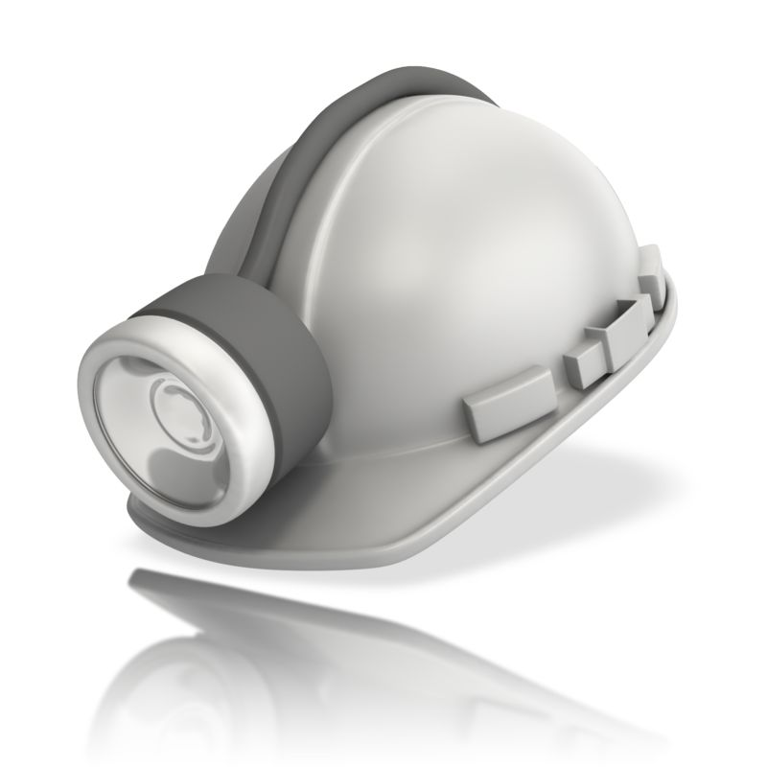
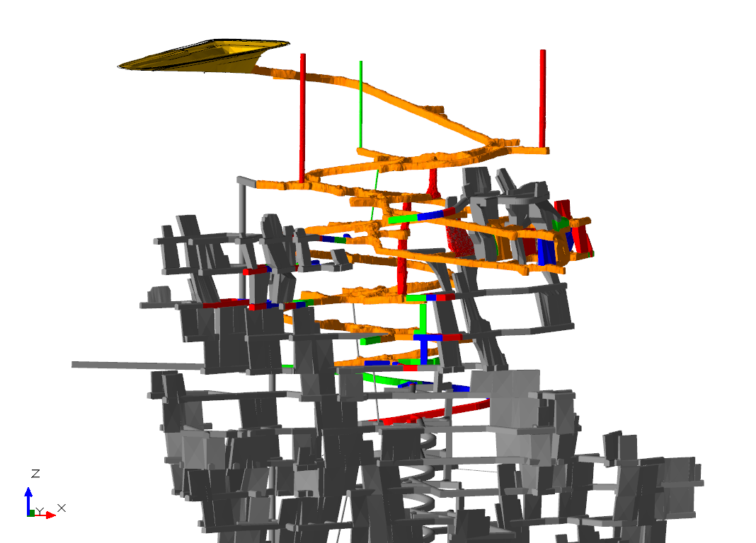
Federation Mine Development
Federation development 1 May 2025

Slide 10
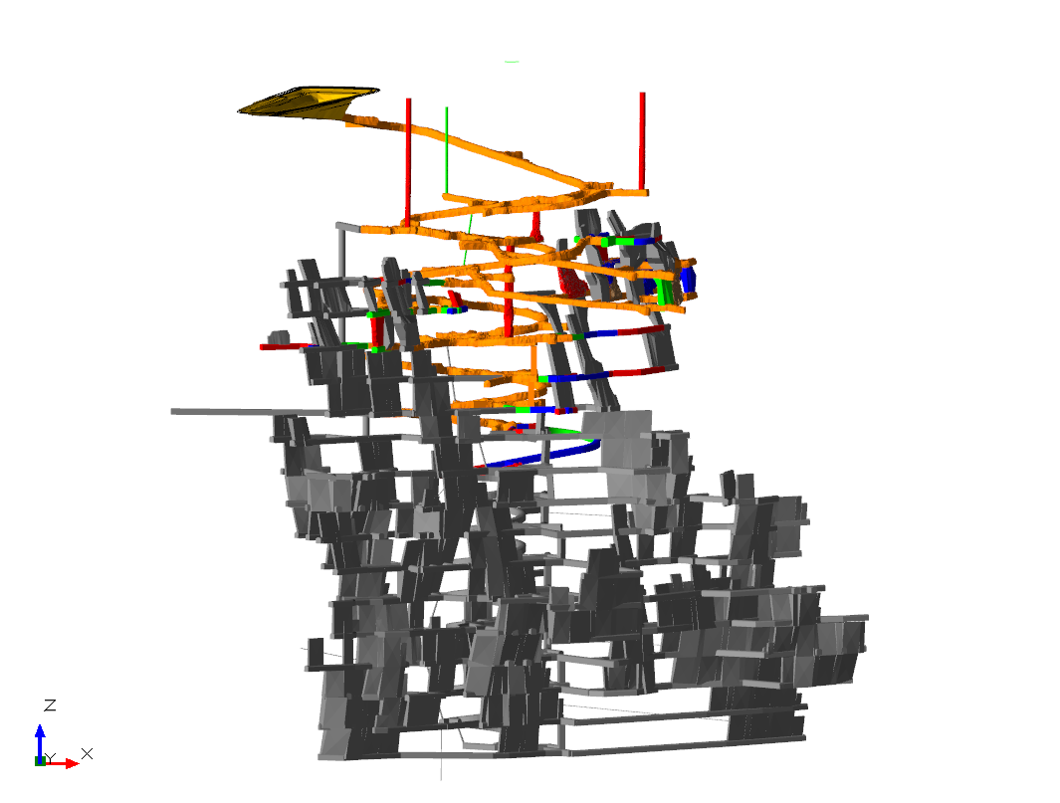
Federation Mine Development
Federation development end of July 2025

Slide 11
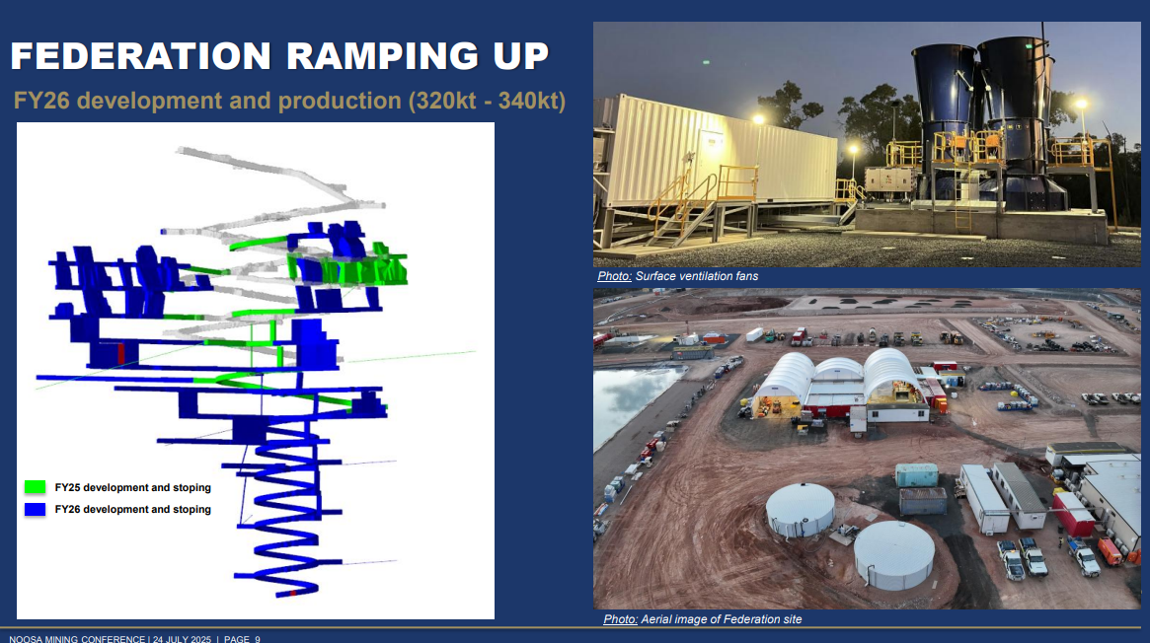

Slide 12
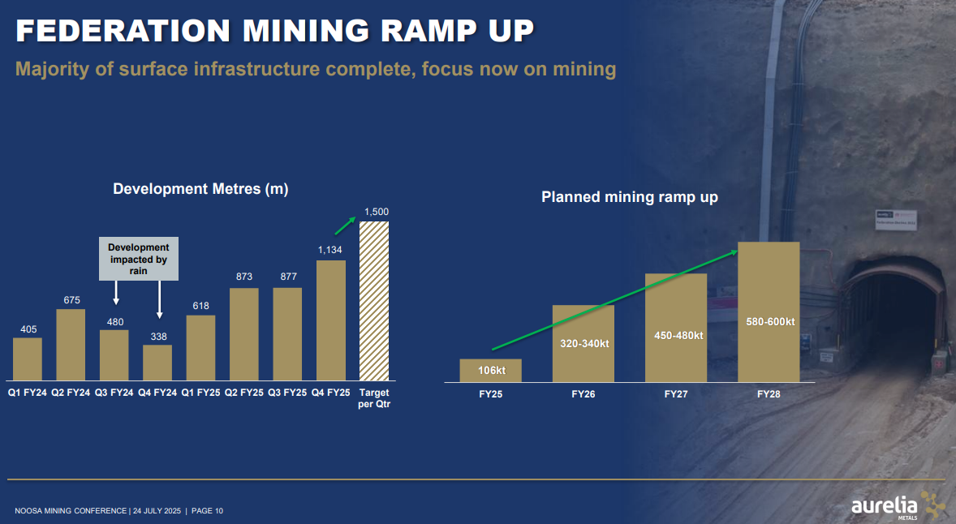

Slide 13
Environment and Community
19 August 2025

Slide 14
Environment and Community
Project Approval Modification — MOD 2
As reported at the last CCC meeting the company received approval to modify the project approval on 3 March 2025.
Hera/Federation is currently updating site Management Plans in line with the MOD 2 assessment and the approved Project Approval.
These plans are being submitted to the relevant Regulatory Authorities for review and approval so that approved activities can proceed.
As each plan is approved by the regulator, it will be uploaded to the Aurelia website and the superseded plan will be removed.

Slide 15
Environment and Community
Environmental Priorities, Improvement Initiatives and Complaints
Priorities and improvement initiatives
Follow‑up actions arising from questions at the last CCC meeting regarding public roads:
Allocation of Federation VPA funding to roads
Email sent to Cobar Shire Council (CSC) on 18 August 2025 requesting a breakdown; awaiting response.
Pull‑off bay on Priory Tank Road to assist truck movements
Haulage contractor instructed to comply with approved access times to Federation.
Hera/Federation investigating access‑card controls on the Gallagher system to prevent access before approved hours.
Intend to include in the next modification approval a provision to allow haulage trucks to park within the Project Approval boundary (off the public road); documentation will be prepared to avoid non‑compliance.
Road line‑marking and shoulder condition on Priory Tank Road
Line‑marking on Nymagee and Priory Tank Roads completed ~2–3 months ago by CSC.
Nymagee to Four Corners Farm Stay line‑marking on the old bitumen raised with CSC at the Roads Meeting in Tilpa on 6 August 2025 (via Nymagee Progress Association); awaiting response.
Heavy patching of shoulders on Priory Tank Road scheduled for week commencing 18 August 2025 by CSC.
School‑bus warning signage
School‑bus sign installed on 17 July 2025 on the Federation HV access road before entering Burthong Road to remind drivers of school buses.

Slide 16
Environment and Community
Environmental Priorities, Improvement Initiatives and Complaints
Priorities and improvement initiatives
Dewatering remains a priority and challenge. Preliminary investigations have commenced into transferring underground water from Federation to underground at Hera.
This would require a modification to the Project Approval and environmental and water licensing. Benefits include storing groundwater close to the Hera Processing Plant and reducing evaporation.
Complaints:
1 complaint was received since the last meeting:
1 compliant relating to noise from Nymagee Mine exploration activities.
Non-Compliance:
Three non compliances have been reported since the last meeting. These relate to findings from the Independent Environmental Audit (IEA). All have been reported to the Environment Protection Authority, Department of Planning, Housing and Infrastructure (DPHI), Cobar Shire Council, Bogan Shire Council and the Resources Regulator:
18/07/25 - Failure to submit the IEA report and Response to Audit Recommendations (RAR) by the due date.
09/07/25 - PM2.5 dust monitoring has not been undertaken for the operation, as required by the Project Approval.
09/07/25 - HVAS exceedance for 24 April 2025 not reported to regulatory authorities as required by the Project Approval.
Actions:
IEA report to be submitted to DPHI by 20 August 2025.
Install PM2.5 dust monitor with air quality consultant to finalise scope, select location, and review the Hera/Federation air quality network.
Tighten internal reporting of HVAS exceedances to prevent recurrence.
To lodge a complaint, email: Hera.community@aureliametals.com.au or phone: 1800 437 264 (call center 24/7)

Slide 17
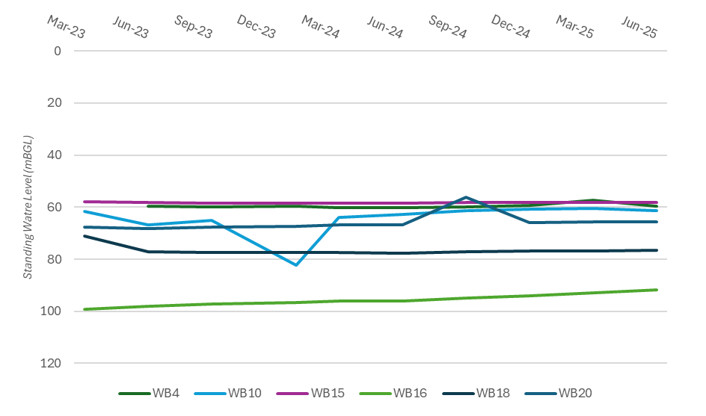
Groundwater Monitoring
Groundwater monitoring completed in June.
Quarterly SWL for Hera Bores.

Slide 18
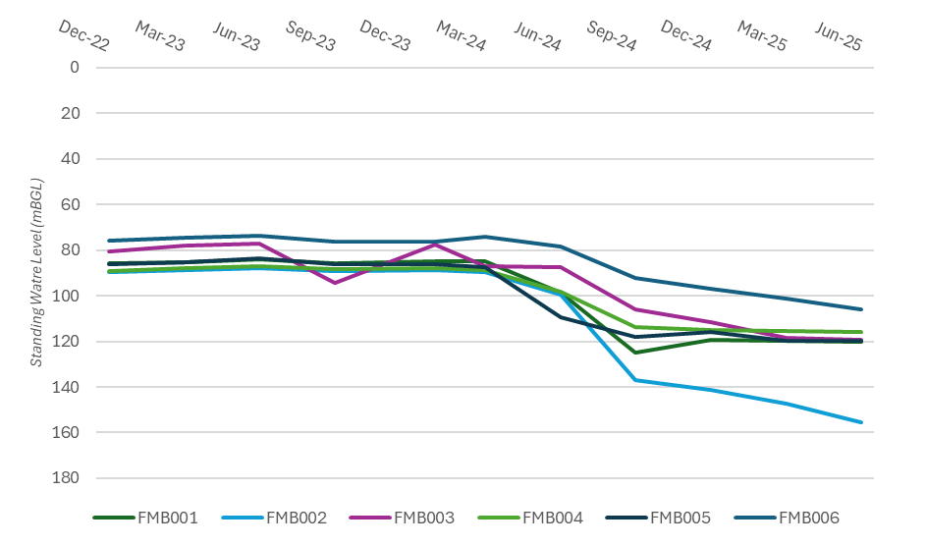
Groundwater Monitoring
Groundwater monitoring completed in June.
Quarterly SWL and water quality for Federation bores

Slide 19
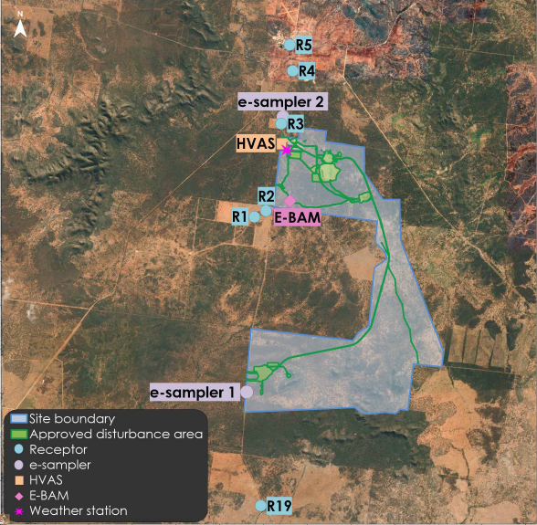
Air Quality Monitoring network

Slide 20
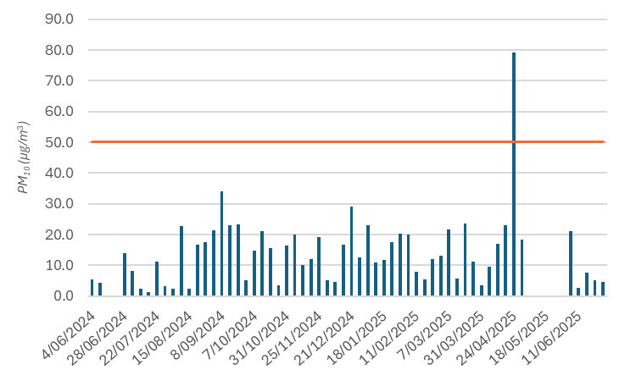
Air Quality – HVAS PM₁₀
Data for May is yet to be received.

Slide 21
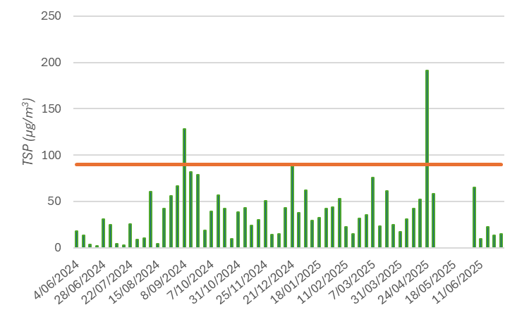
Air Quality – HVAS TSP
Data for May is yet to be received.

Slide 22
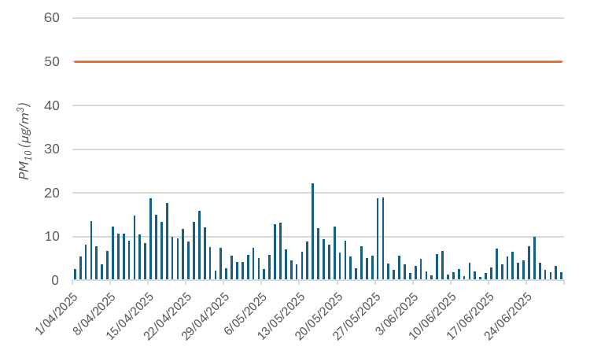
Air quality - EBAM
EBAM average daily concentrations of PM₁₀. Comparison to NEPM criteria

Slide 23
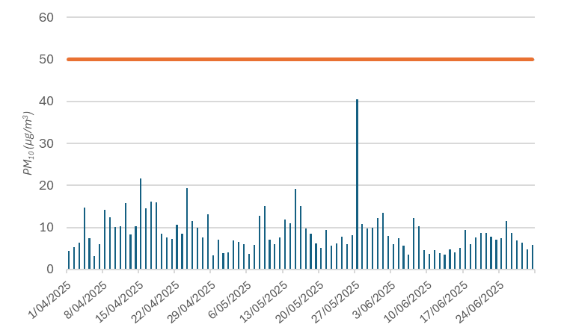
Air Quality – E-Sampler 1
E-Sampler 1 has had intermittent issues resulting in poor data capture. The sampler was serviced on 6 August 2025

Slide 24
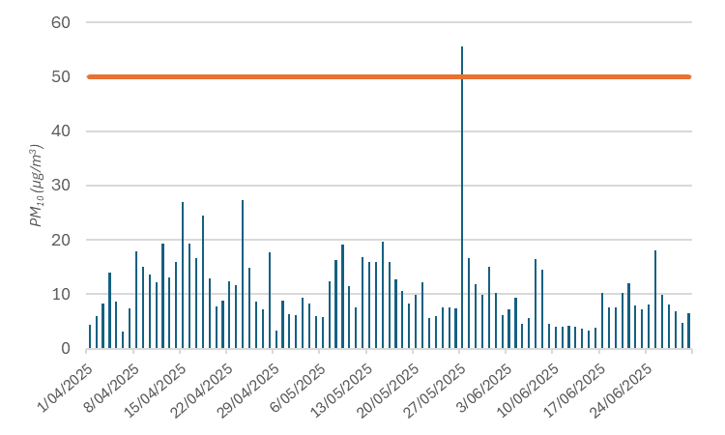
Air Quality – E-Sampler 2

Slide 25
Trucking to Peak
Note – Return trip from Federation to The Peak is counted as two movements.

Slide 26
Blasting
Number of blasts each month were:
April – 68
May – 76
June – 72
No exceedances were recorded.

Slide 27
Exploration
19 August 2025

Slide 28
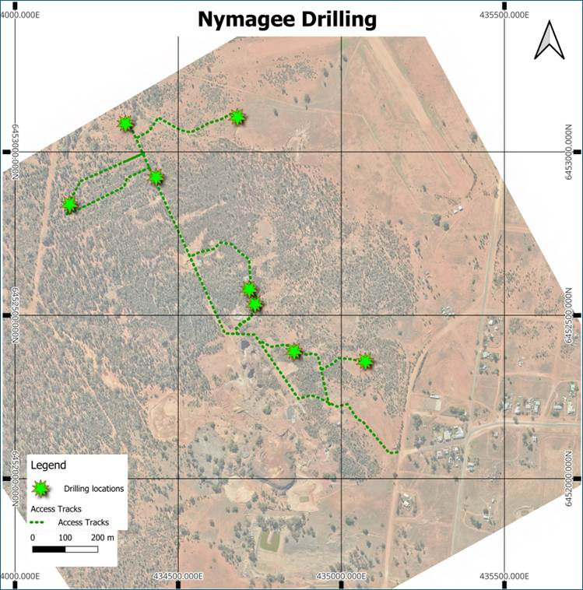
Exploration
“Nymagee Mine” is still the current focus for exploration in Nymagee area. A notification alerting residents to the works was emailed and circulated on 21 July 2025.
Nymagee District Exploration Surface drilling continued at Federation West throughout the quarter, aimed at extending mineralisation along strike and at depth from the discovery drillholes. 4,971m were drilled during the quarter and progressive results were announced during the quarter (see ASX announcement dated 18 June 2025 ‘Nymagee District Exploration Update’). Drilling is ongoing at the end of the quarter.
A second surface drill rig was mobilised to Nymagee North during the quarter and drilled 2,425m to test for extensions to historical mineralisation, targeting ~750m north of the Nymagee Main Zone. Drilling is ongoing at the end of the quarter.
Regional activities in the Nymagee District during the quarter included initiation of aircore drilling at the Lyell project area to assess basement geochemistry over Induced Polarisation chargeability anomalies (see ASX announcement dated 18 January 2023 ‘Survey Results – Correction’). Drilling is ongoing at the end of the quarter and 1,783m has been drilled to date.
Nymagee District Exploration update provided. An extract of the announcement to the ASX has been circulated to the committee. The full document can be found at: https://aureliametals.com/wp-content/uploads/2025/06/ASX-Announcement_Nymagee-Exploration-Highlights.pdf

Slide 29
